Slide 1
Debugging LDAP connection in CP4D 2.5 — Tomasz Hanusiak Customer Experience Team

Slide 2
Test LDAP servers to use
9.30.245.176 [Internal]
https://github.ibm.com/PrivateCloud/usermgmt/blob/dsxl-dev/server-src/test/endpoints/v1/auth-tests.js#L216
apim-ad.hursley.ibm.com [Internal] – Active Directory
https://github.ibm.com/apimesh/devportal/wiki/LDAP-endpoints
ldap.forumsys.com [Public] – OpenLDAP
https://www.forumsys.com/tutorials/integration-how-to/ldap/online-ldap-test-server/

Slide 3
Testing via ldapsearch
# ldapsearch -h 9.30.245.176 -p 389 -b "DC=wdp,DC=com" -D jyin@wdp.com -w Hot6cold
# ldapsearch -h apim-ad.hursley.ibm.com -b "CN=Users,DC=apim,DC=ad,DC=hursley,DC=ibm,DC=com" -D ldapbind -w Qwert123 -x sAMAccountName=einstein
# ldapsearch -h ldap.forumsys.com -p 389 -b 'ou=scientists,dc=example,dc=com' -s base -D 'uid=einstein,dc=example,dc=com' -w password -d999

Slide 4
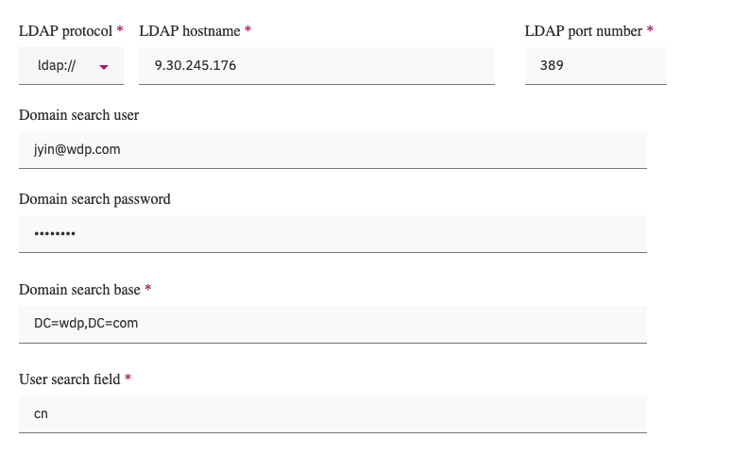
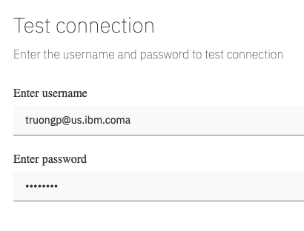
Testing via the CP4D UI
Navigate to: https://<IP> zen-admin/#/usermgmt-ui/ldap
Click on Test connection

Slide 5
Testing via the ICP4D UI
Navigate to: https://<IP>:31843/zen/#/manageUsers
Click on Connect to your LDAP server

Slide 6
Testing via the ICP4D UI
Navigate to: https://<IP>:31843/zen/#/manageUsers
Click on Connect to your LDAP server

Slide 7
Enabling debug logs – part 1
Stop the current pods
# kubectl scale Deployment/usermgmt --replicas=0
Change the default image policy
# kubectl edit Deployment/usermgmt
Change imagePullPolicy: IfNotPresent to imagePullPolicy: Always
Add variable: DEBUG with value: '*'
Run an instance of the usrmgmt image (the tag/namespace may differ depending on CP4D version)
# docker rm --force "/ldap" > /dev/null 2>&1
# docker run -dit --name ldap --entrypoint tail docker-registry.default.svc:5000/ddd/privatecloud-usermgmt:v2.5.0.0-210 -f /dev/null
Perform changes inside of the docker container
# docker exec -it -u 0 ldap sh
# cd node_modules/ldapjs/lib/client/
# sed -i "s/stream: process.stderr,/stream: process.stderr,level: 'trace',/g" index.js
# exit

Slide 8
Enabling debug logs– part 2
Backup the original image (one line)
# docker tag docker-registry.default.svc:5000/ddd/privatecloud-usermgmt:v2.5.0.0-210 docker-registry.default.svc:5000/ddd/privatecloud-usermgmt:v2.5.0.0-210.org
Push the modified image
# docker commit --change='ENTRYPOINT ["/startup.sh"]' ldap docker-registry.default.svc:5000/ddd/privatecloud-usermgmt:v2.5.0.0-210
# docker push docker-registry.default.svc:5000/ddd/privatecloud-usermgmt:v2.5.0.0-210
Restore the deployment (use one replica for testing, then increase to 2)
# kubectl scale Deployment/usermgmt --replicas=1
Get the running pods
# kubectl get po | grep user
Monitor the logs & test from UI
# kubectl logs usermgmt-ff795bb8d-pxjrm --since=1h -f

Slide 9
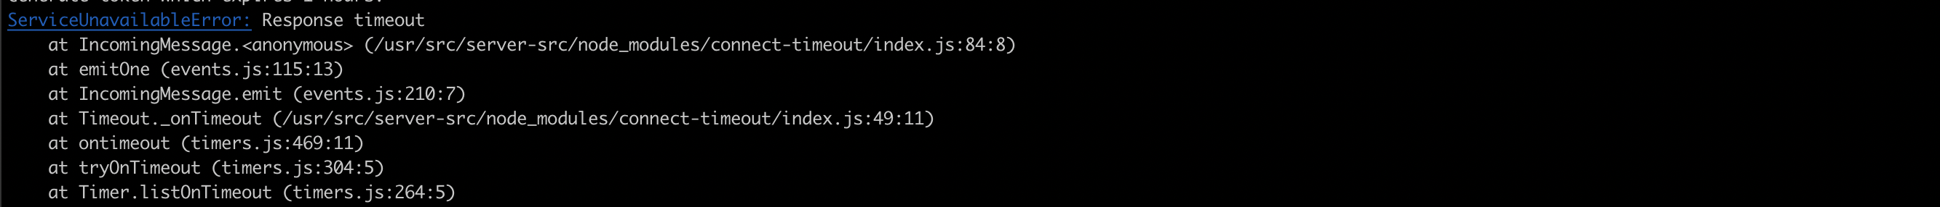
Enabling debug logs– part 3
Capture the errors:
- invalid credentials (status 49 - OpenLDAP)
- invalid credentials (status 49 – AD)
- invalid port/URI

